Slide 1

While Loop Statements
A while loop is usually used to repeatedly execute a statement/block of statements as long as a given condition is TRUE (nonzero).
Syntax:
while (condition)
{
// body statements
}

Slide 2
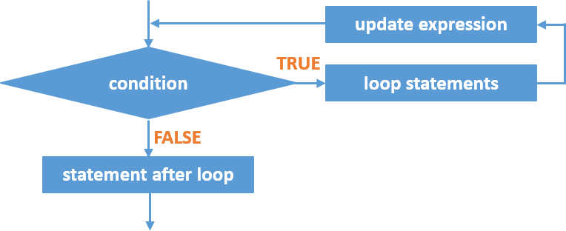
Flowchart

Slide 3
Order of operations
The condition is evaluated. The condition may be a direct integer value, a variable, or an expression.
Any nonzero value is considered TRUE.
If the condition contains a variable, the variable must be initiated before it is used.
If the condition is TRUE, the statements within the loop will be executed including the update expression.
If the condition is FALSE, the loop statements will not be executed. Program control jumps to the next statement after while loop.
The condition is evaluated again. Step 2 is repeated until the condition becomes false or loop is terminated using break statement.

Slide 4
Do While Loop
A do-while loop is usually used to repeatedly execute a statement/block of statements as long as a given condition is TRUE (nonzero).
The condition is tested after execution of the do-while loop’s body
A statement/block of statements within the do-while loop will be executed at least one time.
Syntax: do {
// body statements
} while (condition);

Slide 5
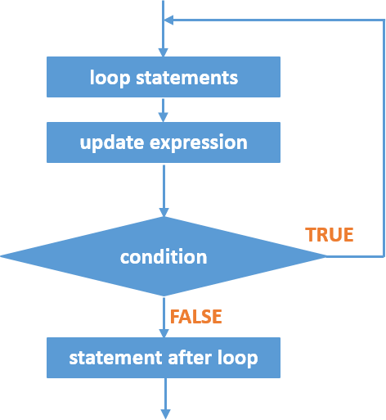
Flowchart

Slide 6
Order of Operations
Statements, including the update expression, within do block are executed.
The condition is evaluated. The condition may be a direct integer value, a variable, or an expression.
Any nonzero value is considered TRUE.
If the condition contains a variable, the variable must be initiated before it is used.
If the condition is TRUE, the statements within the loop will be executed again, including the update expression.
If the condition is FALSE, the program control jumps to the next statement after do-while
loop.

